Slide 1




Optimizing Visual Studio Code For Powershell
+
justinwgrote
Justin Grote, Microsoft MVP
Datacenter Solutions Architect

Slide 2
Optimizing Visual Studio Code For Powershell
+
justinwgrote
Justin Grote, Microsoft MVP
Datacenter Solutions Architect

Slide 3
Recommended Prerequisites
VS Code Getting Started https://code.visualstudio.com/docs/getstarted/introvideos
VS Code Powershell Getting Started https://tinyurl.com/LearnVSCodePWSH
justinwgrote
Justin Grote, Microsoft MVP
Datacenter Solutions Architect
+

Slide 4
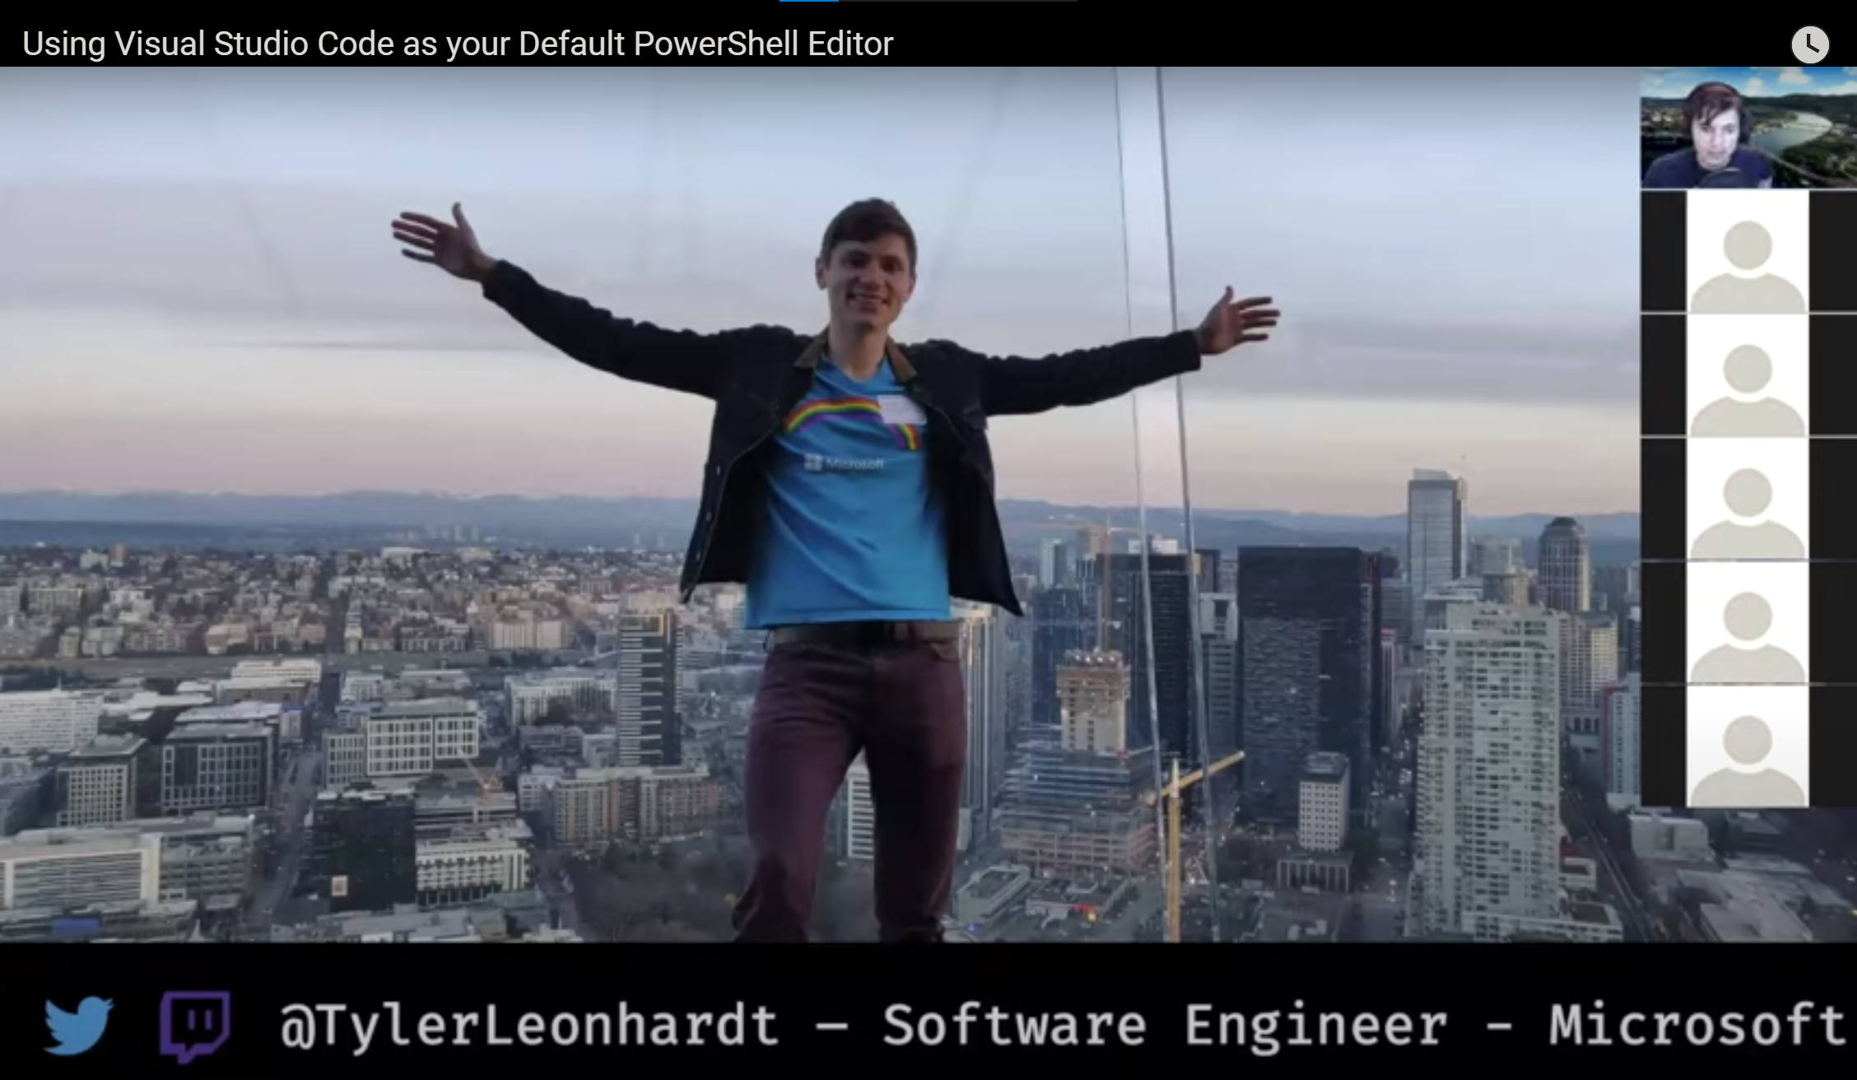
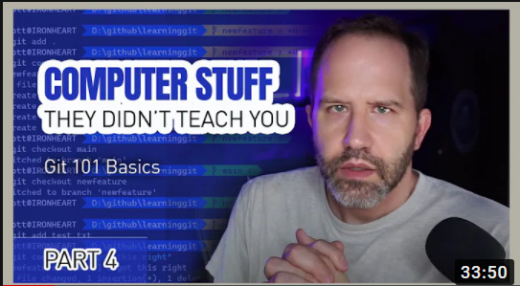
Recommended Prerequisites
Using VSCode as your Default Powershell Editor https://youtu.be/LF0Srh9hxj8
justinwgrote
Git 101 Basics: Scott Hanselman https://youtu.be/WBg9mlpzEYU
Justin Grote, Microsoft MVP
Datacenter Solutions Architect
+

Slide 5
Optimizing Visual Studio Code For Powershell
+
justinwgrote
Justin Grote, Microsoft MVP
Datacenter Solutions Architect

Slide 6
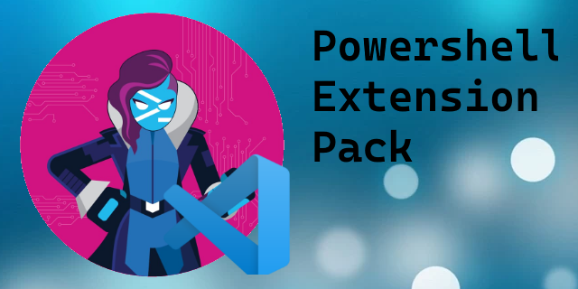
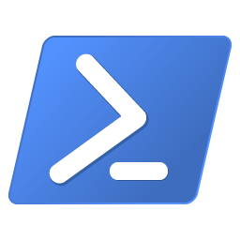




VSCode PS Profile
Settings Tweaks
Settings Sync

Slide 8
VSCode PS Profile
Settings Tweaks
Settings Sync

Slide 9
Settings Sync

Slide 10
VSCode PS Profile
Settings Tweaks
Settings Sync

Slide 11
Settings Tweaks

Slide 12
VSCode PS Profile
Settings Tweaks
Settings Sync

Slide 13
Visual Studio Code PowerShell
Profile

Slide 14
VSCode PS Profile
Settings Tweaks
Settings Sync

Slide 15
VSCode PS Profile
Settings Sync
Settings Tweaks

Slide 16
Thank you!
justinwgrote
Justin Grote, Microsoft MVP
Datacenter Solutions Architect

